Slide 1


Identifying SNPs involved heat and drought adaptation
The role of post-transcriptional modification in local adaptation
Baxter Worthing
Csenge Petak
Kerria Burns

Slide 2
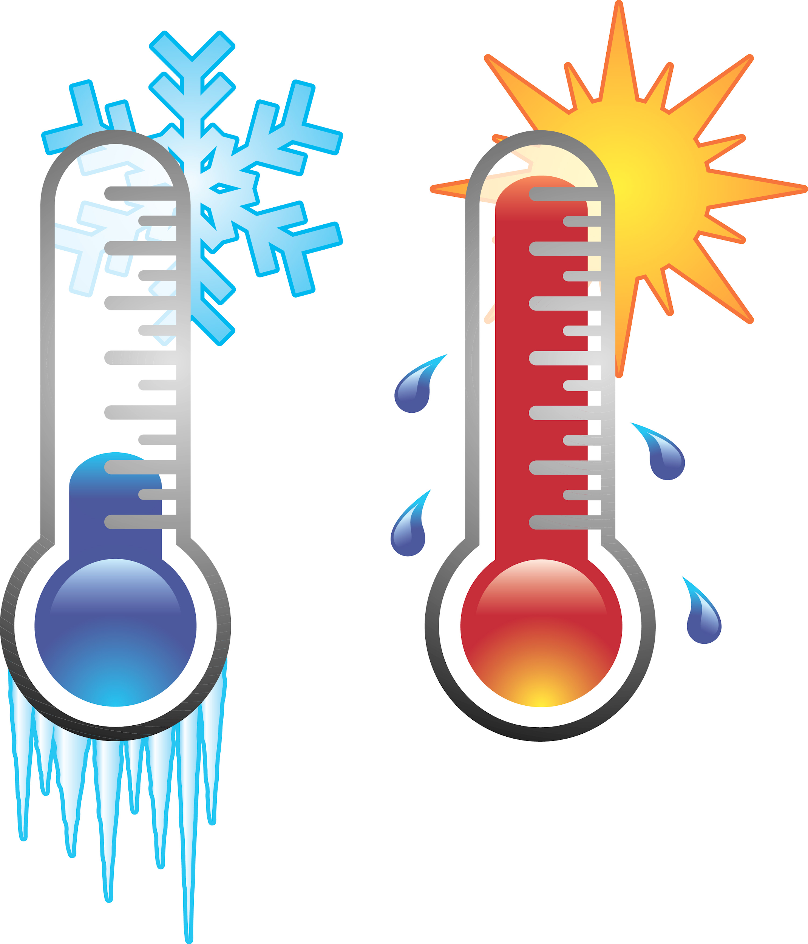
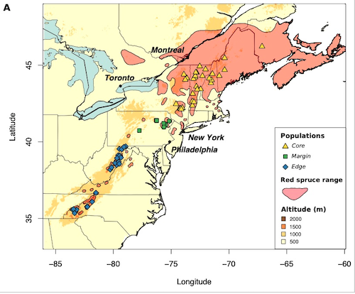
Red spruce
“Core” population
Local “Hot and dry” vs “Cold and wet” climates
Due to differences in latitude/ elevation/ south- or north-facing slope
Relatively shorter distance -> gene flow
“Hot and dry” ~ future climate +5 °F by 2050 (Byers 2010)
Notes:
We decided to investigate red spruce populations belonging to the “core” region marked with a red circle (because those are the individuals that were involved in the transcriptomic study) and we compared populations coming from different local climates, hot and dry or cold and wet. The differences in temperature and precipitation could be due to latitude, elevation, or whether they are located on a south or north facing slope. Our aim was to identify genes potentially under selection out of curiosity to see whether such short distance and high gene flow allows for local adaptation and also because genes under selection involved in heat/drought tolerance could play a very important role with the ongoing climate change

Slide 3
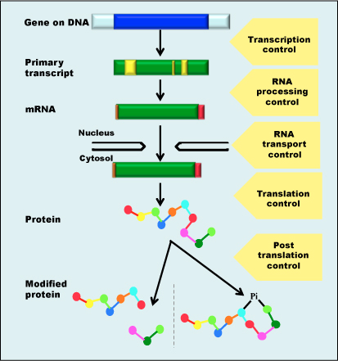
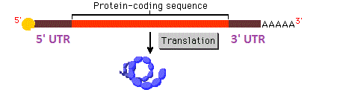







5’ and 3’ UTRs
UTRs bind regulatory proteins or microRNAs -> altered polyadenylation (~stability of the mRNA), nuclear export, translation efficiency, and localization
Notes:
So when we exposed hot and dry individuals to heat and drought their transcriptomic response was not different to cold and wet individuals, and we hypothesised that differential gene expression could still be going on but on a different level. Untranslated regions on the mRNA can cointain binding sites for proteins and microRNAs the influence when and where and if the mRNA is translated into a protein. SNPs in these regions have been associated with adaptation in numerous species, like humans, aspnes, chiclid fish, cattle, drosophila, sunflower and beans.

Slide 4
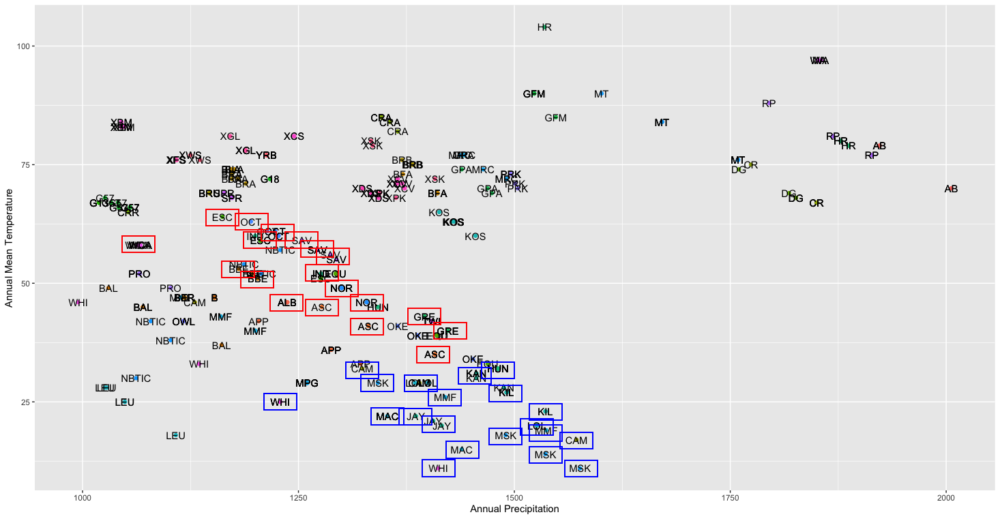
Population selection from bioclim data
= HotDry
= Coldwet
10 populations per source climate
113 individuals in total =
59 in HD,
54 in CW
Notes:
We selected 10 populations for each group (hotdry and coldwet) based on the bioclim data Anoob kindly shared with us. On the plot populations marked with red were considered as hotdry while others and coldwet. Overall, we analysed 113 individuals more or less equally partitioned into the two groups

Slide 5
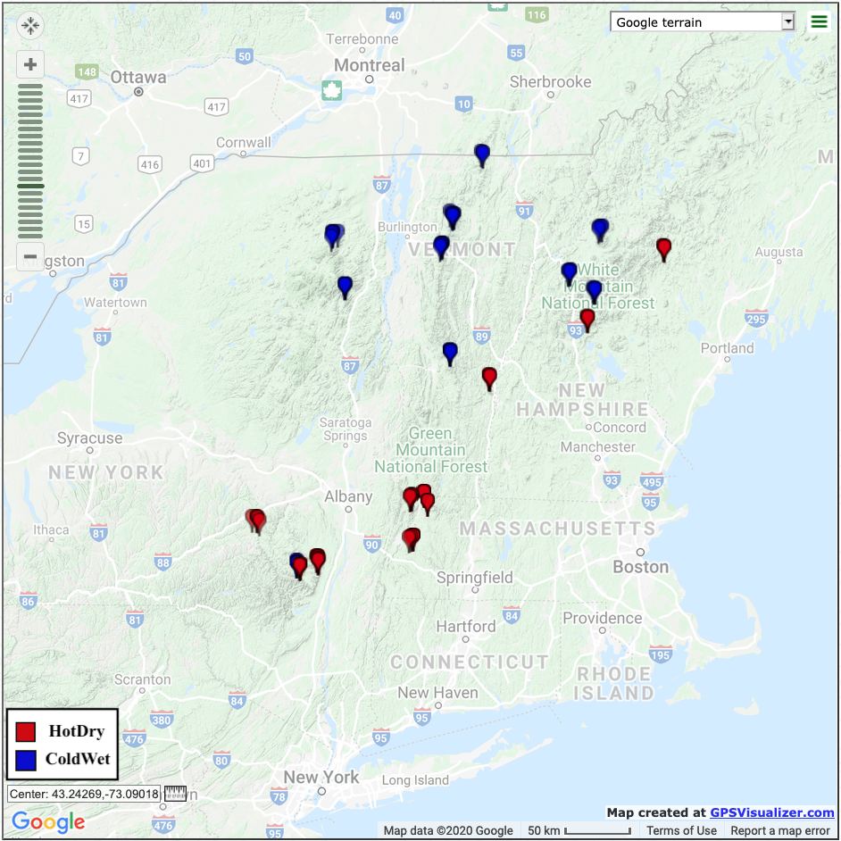
Geographical location of selected pops
Notes:
After we selected our subjects based on the bioclim data, we used a program called GPSVisualizer to place their sampling location on the map. As you can see, coincidentally all coldwet populations were locate more to the north, thus the two groups were geographically distinct, even though some pairs of populations were quite close to one another.

Slide 6
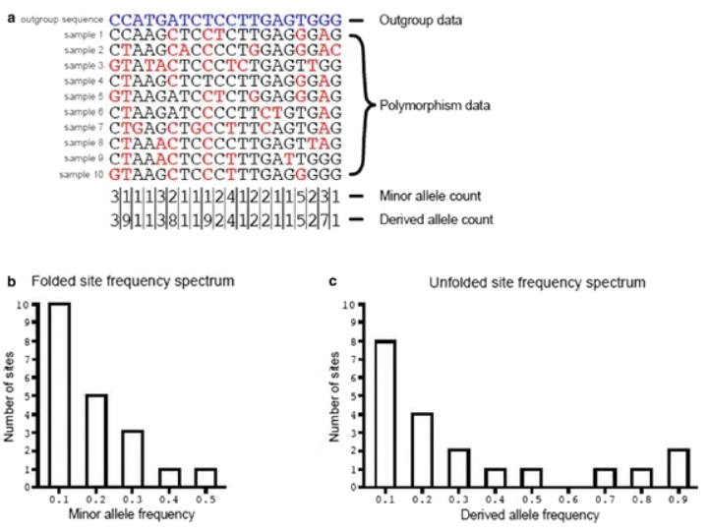
SFS and folded SFS
Booker et al. 2017

Slide 7
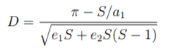
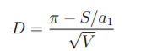
Tajima’s D
Conceived by Fumio Tajima in 1989.

Slide 8
Fst
-introduced in 1948 by Sewall Wright
-estimate of population structure
-conceptual ambiguity remains

Slide 9
Gene Ontology: what is it?
Molecular function Cellular component Biological process
Category overlap, multiplication
Biological process

Slide 10
Genome wide selection imprints
(I) phylogenetic footprinting,
(II) detecting increased rates of functional mutations,
(III) evaluating divergence versus polymorphism,
(IV) detecting extended segments of linkage disequilibrium,
(V) evaluating local reduction in genetic variation,
(VI) detecting changes in the shape of the frequency distribution (spectrum) of genetic variation,
(VII) assessing differentiating between populations (FST), and
(VIII) detecting excess or decrease in admixture contribution from one population

Slide 11
Finding 3’ UTRs
Step 1: Map RNA-seq reads to reduced reference
Inputs: 76 FASTQ, Reduced P. abies reference
Output: 76 BAMs
Software: Tophat2
Step 2: Index BAMs
Inputs: 76 BAMs
Output: 76 BAI
Software: Samtools
Step 3: Merge BAMs
Inputs: 76 BAMs
Output: 1 BAM
Software: Samtools
Step 4: Subset reference for non-coding regions
Inputs: Reduced P. abies reference, gff of coding domains
Output: BED file of non-coding regions
Software: Bedtools
Step 5: Find depth of RNA-seq read coverage
Inputs: BED file of non-coding regions, merged BAM
Output: BED coverage file
Software: Samtools
Step 6: Find regions of high coverage
Inputs: BED coverage file
Output: BED of predicted UTRs
Software: R
UTRs must:
Be >=150bp
Have RNA-seq read depth >=5
Not overlap annotated CDS
Notes:
One of the main questions we wanted to ask in our analysis was if there differences in the 3’ UTRs of individuals from CW or HD climates that could perhaps contribute to phenotypic differences. The first step in this process was annotating locations of the 3’ UTRs with the P. abies genome. As 3’ RNA seq reads should align primarily to the 3’ UTR, we chose to use the depth of these reads as our guide of finding UTRs. We did this by aligning the RNA-seq reads to the reduced reference genome with Tophat2. For a region to be considered a UTR, it needed to be at least 150bp in length, have continuous coverage of RNA-seq reads with depth > 5 and not overlap a region annotated as protein coding.

Slide 12
Calling SNPs, Calculating Per-site Fst
Step 1: Build mpileup of genotype likelihoods for HD and CW individuals
Inputs: 113 exome capture BAMs, Reduced P. abies reference
Output: 1 BCF
Software: bcftools
Step 2: Call SNPs
Inputs: 1 BCF
Output: 1 VCF
Software: bcftools
Step 3: Calculate Per-site Fst
Inputs: 1 VCF, list of HD/CW individuals
Output: Fst values for all SNPs
Software: vcftools
P-val < 1.1e-3
mapping Q > 20
Filter “outliers” (top 2% of distribution)
Step 4: Filter SNPs for overlap with genes and predicted UTRs
Inputs: 1 VCF, gff of coding regions, BED of predicted UTRs
Output: BED of SNPs overlapping UTRs and genes
Software: bcftools
Step 5: Find Fst outliers overlapping UTRs and genes
Inputs: BED of outlier SNPs,
BED of SNPs overlapping genes/UTRs
Output: BED of Fst outliers overlapping genes or UTRs
Software: R
Step 6: Find genes near UTRs containing Fst outliers
Inputs: BED of Fst outliers overlapping UTRs
Output: List of genes near UTRs with Fst outliers Software: bedtools
Congenie for functional enrichment/ finding function
Notes:
In order to calculate per-site Fst between CD and HW individuals, we first called SNPs across all 113 individuals and built one huge VCF containing them. We required a significance cutoff of .001 and a mapping quality > 20. We calculated Fst for each of these SNPs using the Weir and Cockerham 1984 method. We then looked for Fst outlier SNPs that also overlapped annotated coding regions or our predicted UTRs. for any Fst outlier overlapping a UTR, we found the nearest gene.

Slide 13
Quantifying Diversity and Selection
Step 1: Calculate Genotype Likelihoods and allele freq. from exome capture data
Inputs: 59 HD BAMs, 54 CW BAMs, Reduced P. abies reference
Output: MAF/GL/saf.ix (CW & HD)
Software: AGSD
Step 2: Quantify nucleotide diversity, build SFS
Inputs: saf.idx (CW & HD)
Output: SFS (CW & HD)
Software: ANGSD: realSFS
Step 3: Calculate Theta
Inputs: SFSs, 59 HD BAMs, 54 CW BAMs, Reduced P. abies reference
Output: thetas.idx
Software: ANGSD
Step 4: Calculate per-site diversity estimates
Inputs: SFSs, saf.idx Output: thetas.idx
Software: ANGSD: real SFS, saf2theta
Step 5: Visualising
Inputs: SFSs, thetas.idx.pestPG, pernuc.thetas.idx
Output: png
Software: R
Congenie for functional enrichment/ finding function
https://github.com/Cpetak/EG_final_project/blob/master/lab_book.md
Notes:
We used ANGSD for producing site frequency spectra and calculating Tajima’s D. Doing so required that we first calculate genome likelihoods and allele frequencies using the 59 and 54 exome capture BAM files corresponding to our Hot Dry and Cold Wet groups respectively. We could then use the metrics assess per-site diversity.

Slide 14
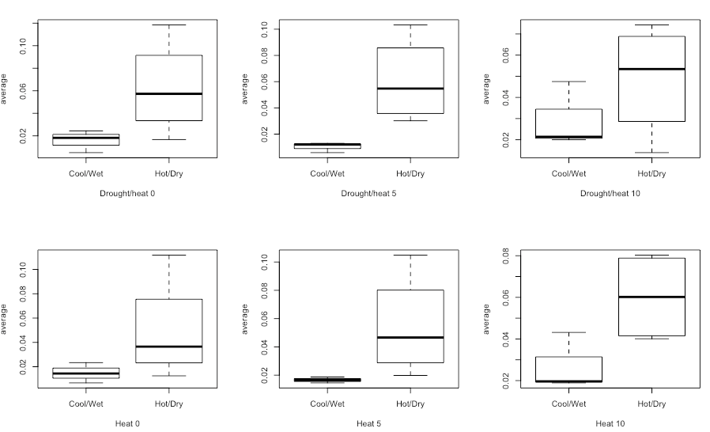
Phenotypic differences - harvest data
*
*
Notes:
Anoob kindly provided harvest data, 7 variables in total (eg Live crown height, Stem weight, Needle weight)
General trend of HotDry being bigger (ie taller and heavier) in different treatments, even when same in control
And significant difference most frequently in heat + drought treatment (as expected) and interestingly, usually on day 5
Here showing Differences in needle weight, * = significance

Slide 15
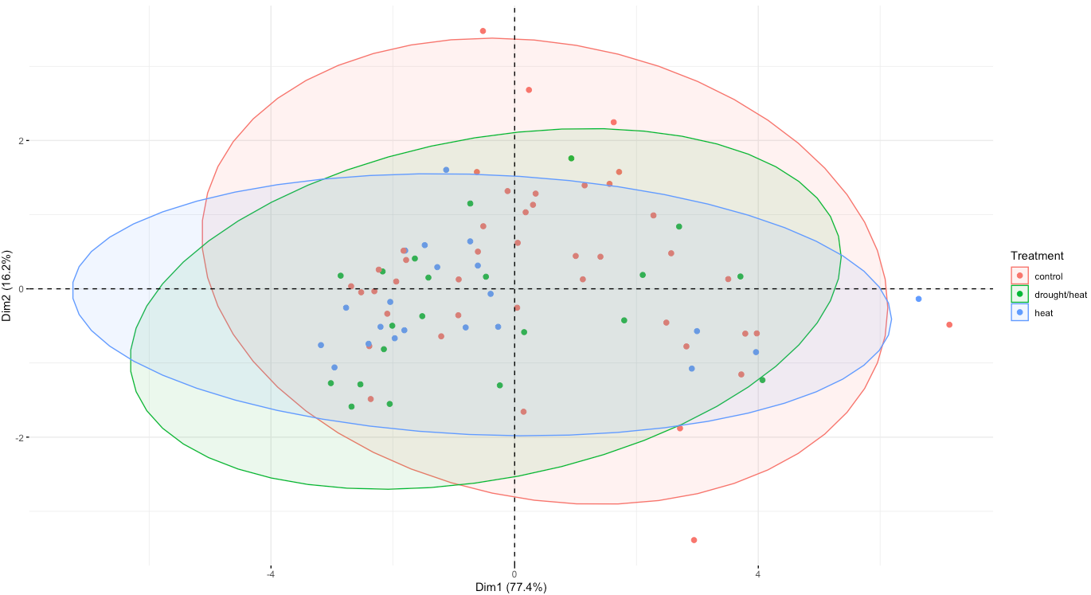
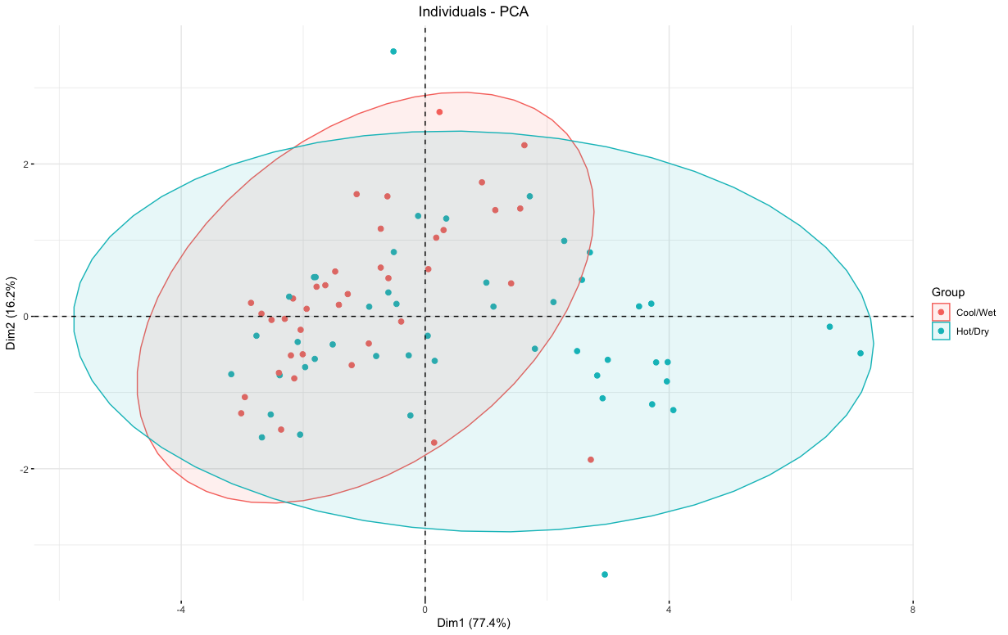
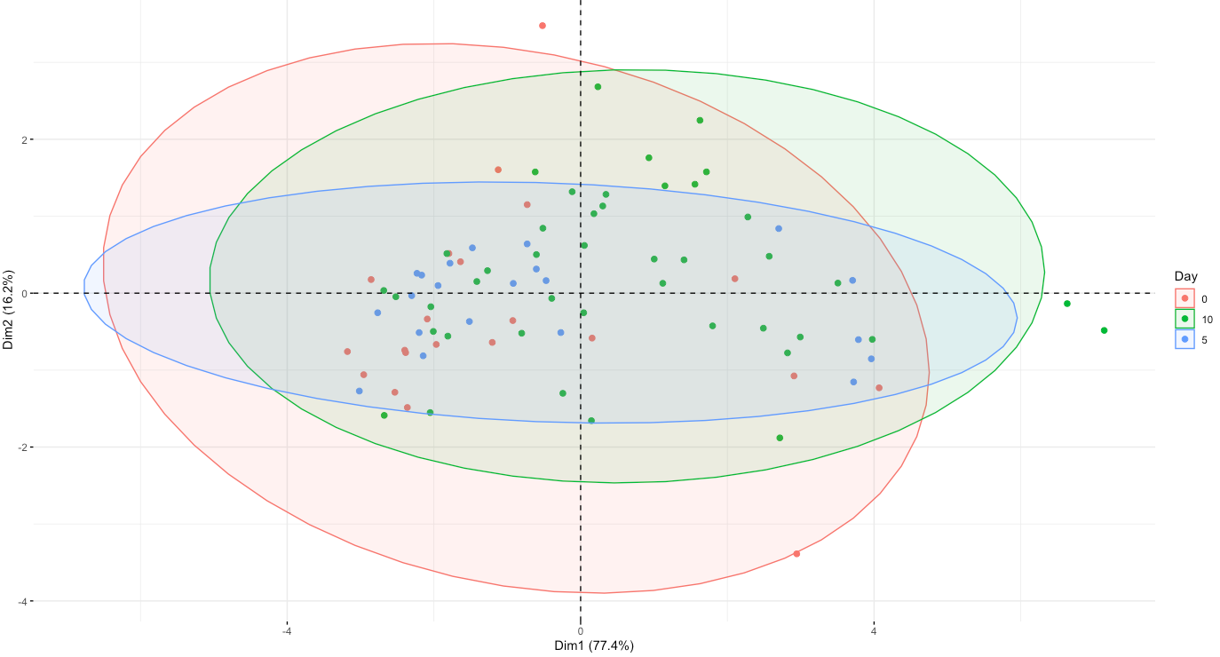
Phenotypic differences - PCA
Notes:
You can kind of see on this PCA that coldwet and hotdry sort of clusters where hotdry varies along PC1 while coldwet varies along PC2. interestingly, even though this is little clustering, it clustered even less by treatment or day
This evidence further suggests role of source climate in phenotype
No differences in transcriptional regulation -> could be effects of translational regulation!

Slide 16
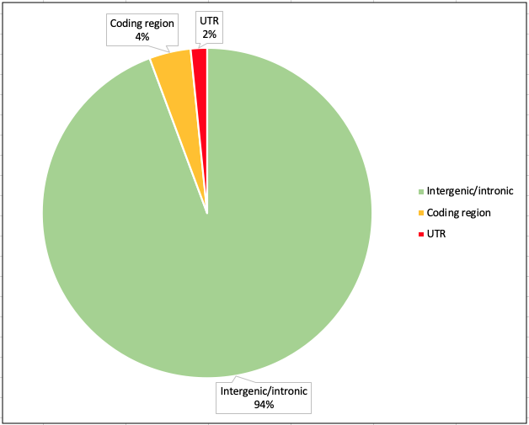
Single Nucleotide Polymorphisms
We identified 15,647,568 SNPs in total.
ColdWet
HotDry
3,864,248
5,093,568
6,689,752
42%
Notes:
Using angsd on the bam files of selected individuals we found around 15 million polymorphic sites, of which 42% was shared between the two groups. The rest were unique to the group. 4% of all SNPs fell within the coding region and 2% in UTRs. It is difficult to compare this percentage to findings of previous studies since they all used very different species and groups with different levels of divergence. Nonetheless, this percentage is similar to what other studies found.

Slide 17
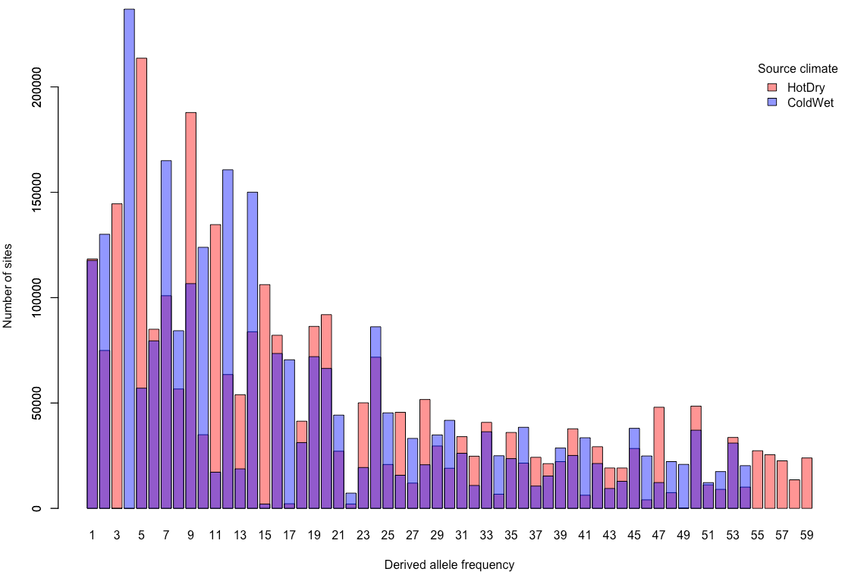
Folded Site Frequency Spectra
Folded SFSs of Hotdry and Coldwet largely overlap
Lack of rare alleles
Notes:
Since we don’t know the ancestral state of alleles, we calculated folded site-frequency spectra for both of the groups. You can see on the barplot the expected distribution of derived allele frequency, however, the tail of the distribution is quite think that indicates a lack of rare alleles in both of the groups.

Slide 18
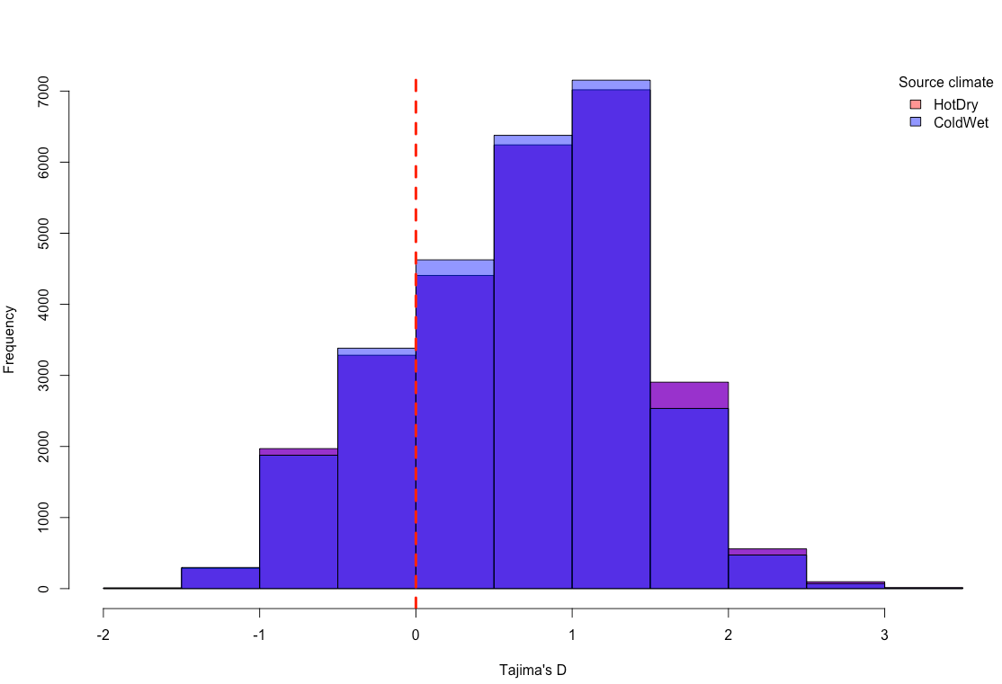
Tajima’s D
Hotdry average = 0.69, Coldwet average = 0.67
Tajima’s D being positive and so 𝜃𝜋 > 𝜃𝑊 mean that there is a lack of rare alleles, consistent with the SFS results.
This could be caused by two processes:
balancing selection
sudden population contraction
Notes:
The distribution of Tajima’s D measured for whole contigs show no difference between Hotdry and Coldwet populations. The average Tajima’s D across the whole genome is also very similar between groups, and they are positive, again indicating a lack of rare alleles. This lack of rare alleles could be explained by 2 processes: balancing selection or sudden population contraction. Knowing the history of these populations, the latter is more likely. But there were regions that had negative tajima’s d that can indicate selection sweep.
,

Slide 19
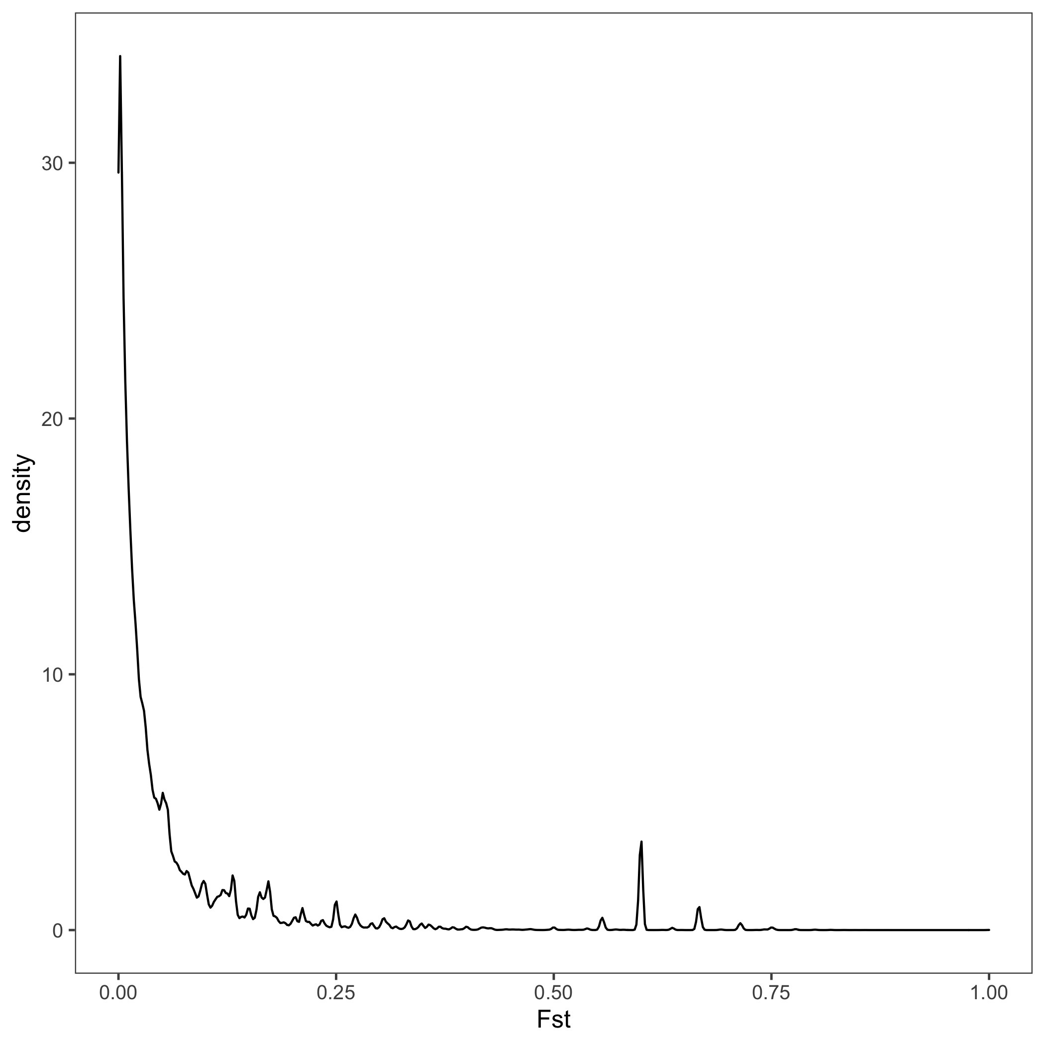
Per-site Fst
Considered Fst > 0.6, 98th percentile, as outliers
40127 SNPs
103 of these fell within UTRs
473 of these fell within annotated coding regions
Didn’t find any functional enrichment for these 576 genes
Most of them had no annotation (“unknown”)
Looked at individual functions of annotated genes

Slide 20
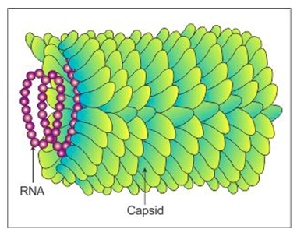
Interesting genes with high Fst
Several methyltransferases, phosphatases, kinases and ATPases^{both}
Post-transcriptional modification:
Nuclear poly A polymerase^{UTR},
Polyadenylate binding (2)^{both},
Pre-mRNA-processing^{UTR},
Pre-mRNA-splicing factor SYF1,
Argonaute (accommodate small RNA such as miRNAs),
Pentatricopeptide repeat (processing, splicing, editing, stability and translation of RNAs) (3)^{both}
Stress response genes:
Cadmium resistance^{UTR}, general disease resistance (14), in addition 7 Tobacco Mosaic Virus resistance genes!
Notes:
High Fst SNPs were found in methyltransferases, phosphatases, kinases and ATPases both in the UTRs and coding regions
And to my great excitement we found high Fst SNPs in proteins involved in post-transcriptional modification like, for example a poly A polymerase had a SNP in its UTR but a splicing factor had a high Fst SNP in the coding region.
We also found 22 genes involved in non heat or drought related stress response, 7 of which were annotated as TMV resistance genes
why?
Phenotypic differences -> more susceptible? One group more exposed than the other?
Or just part of general stress response?

Slide 21
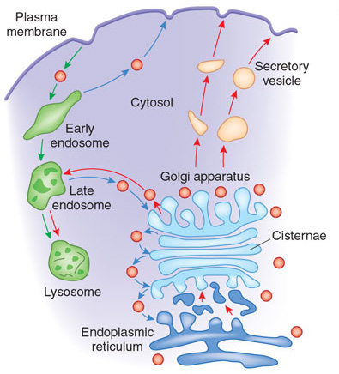
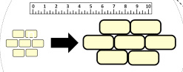
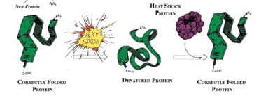
Gene involved in heat stress
Vacuolar protein sorting protein - vesicle trafficking involved in plasma membrane protein composition -> basal tolerance to long-term heat stress, by acclimation of the plasma membrane (Wang et al 2011)
Expansins - regulate cell wall elongation and expansion, roles in enhancing plant tolerance to heat stress (Marowa et al 2016)
Small heat shock chloroplastic - protects oxygen evolution and electron transport of Photosystem II during heat stress (Downs et al 1999)
Chaperone dnaJ chloroplastic - helps with protein folding especially in high temperature (Wang et al 2019)
Notes:
We also found high Fst SNPs in genes involved in heat stress!

Slide 22
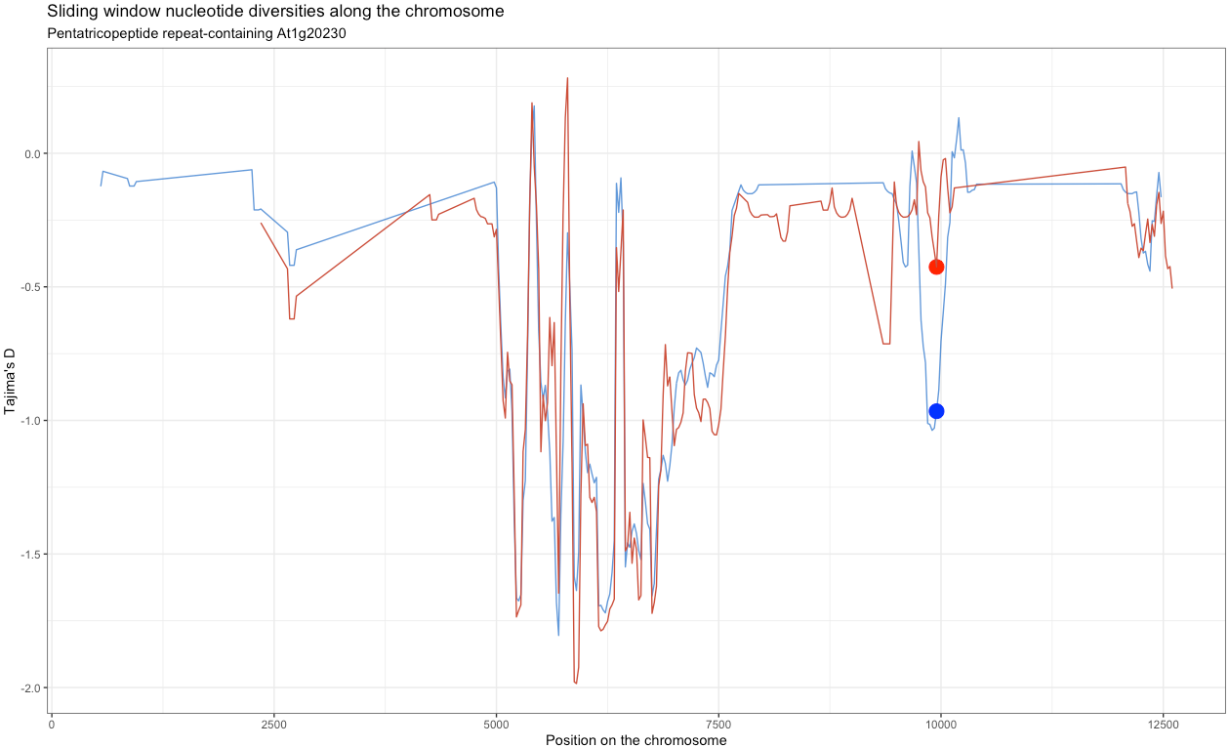
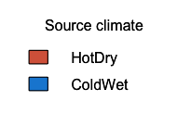
Per-site diversity estimates
Fst = 0.7
Window length of 100 sites, Step size of 25 sites
Coding
UTR
Notes:
To further look for evidence of selection, we calculated per-site nucleotide diversity measures to see if there is any evidence of selection sweep where neighboring nucleotides of selected alleles have a reduced nucletide diversity due to linkage with the benefitial allele
We originally plotted these per-site estimated, however, the image was difficult to analyse because it was too rigid, thus we decided to use a sliding window approach with a relatively small window length
Generally, we saw that SNPs in UTRs with high Fst looked something like this representative plot shown on the slide: the coding region has reduced diversity, but also the region around the SNP in the UTR. y axis Tajima’s d. This is the pentatricopeptide I mentioned before involved in post-transcriptional regulation of gene expression.

Slide 23
PCAngsd
Convert BAM files to Beagle files
Generate summary statistics
Convert to p-values
Demonstrates which genes differ from the null hypothesis of no selection

Slide 24
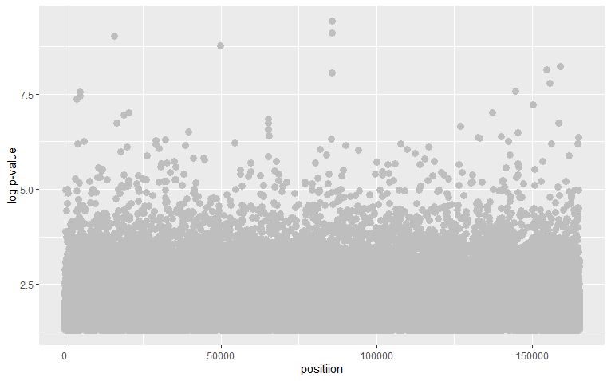
Manhattan plot of significant SNPs

Slide 25
Function of genes with deviation from null hypothesis of no selection
4342 Genes were used for enrichment
GO - Biological Process (355): biological regulation, cellular metabolic process, response to stress, RNA processing
GO - Molecular Function (58): nucleic acid binding, kinase activity
GO - Cellular Component (29): cytoplasmic part, membrane

Slide 26
Conclusion
Source climate affects phenotype in response to heat + drought treatment
The genetic basis of this might be due to differences in UTRs and/or coding regions of proteins involved in post-transcriptional modification
Found high Fst SNPs in these regions with decreased nucleotide diversity
Also found high Fst SNPs in genes involved in heat stress tolerance -> signatures of selection to heat and drought -> climate change?
Overall similar, positive Tajima’s D suggesting population contraction
Role of post-transcriptional modification in adaptation might be underestimated (as present and recent studies suggest)!
Notes:
Pop contraction of CW due to climate change and maybe pop contraction due to increased harvest at those geographic locations - more accessible
low elevation stands in the late 1800s

Slide 27
Future improvements and studies
We only looked at 3’UTRs and genes that were expressed in the transcriptomic study
Better annotation needed for functional enrichment and search for UTRs
Used P. abies reference genome
It would interesting to compare the high Fst SNPs we found to high Fst SNPs in core vs edge populations
Experimental follow-up studies to confirm that UTR variation indeed changes post-transcriptional effect

Slide 28
References
Ashburner, Michael, et al. "Gene ontology: tool for the unification of biology." Nature genetics 25.1 (2000): 25-29.
Gene Ontology Consortium. "The gene ontology resource: 20 years and still GOing strong." Nucleic acids research 47.D1 (2019): D330-D338.
Mayr, Christine. "What are 3′ UTRs doing?." Cold Spring Harbor perspectives in biology 11.10 (2019): a034728.
Oleksyk, Taras K., Michael W. Smith, and Stephen J. O'Brien. "Genome-wide scans for footprints of natural selection." Philosophical Transactions of the Royal Society B: Biological Sciences 365.1537 (2010): 185-205.
Booker, T.R., Jackson, B.C. & Keightley, P.D. Detecting positive selection in the genome. BMC Biol 15, 98 (2017).
Byers, Elizabeth A., James P. Vanderhorst, and Brian P. Streets. "Classification and Conservation Assessment of Upland Red Spruce Communities in West Virginia." (2010).
Barreiro, Luis B., et al. "Natural selection has driven population differentiation in modern humans." Nature genetics 40.3 (2008): 340.
Wang, Lian-Chin, et al. "Involvement of the Arabidopsis HIT1/AtVPS53 tethering protein homologue in the acclimation of the plasma membrane to heat stress." Journal of experimental botany 62.10 (2011): 3609-3620.
Marowa, Prince, Anming Ding, and Yingzhen Kong. "Expansins: roles in plant growth and potential applications in crop improvement." Plant cell reports 35.5 (2016): 949-965.
Downs, Craig A., Samantha L. Ryan, and Scott A. Heckathorn. "The chloroplast small heat-shock protein: evidence for a general role in protecting photosystem II against oxidative stress and photoinhibition." Journal of plant physiology 155.4-5 (1999): 488-496.
Wang, Guodong, et al. "Novel DnaJ protein facilitates thermotolerance of transgenic tomatoes." International journal of molecular sciences 20.2 (2019): 367.
Notes:
Just search for MLA format for all citations on the next slide

Slide 29
References
Ashburner et al. Gene ontology: tool for the unification of biology. Nat Genet. May 2000;25(1):25-9. [abstract | full text]
The Gene Ontology Consortium. The Gene Ontology Resource: 20 years and still GOing strong. Nucleic Acids Res. Jan 2019;47(D1):D330-D338. [abstract | full text]
What Are 3′ UTRs Doing? Christine Mayr
Genome-wide scans for footprints of natural selection
Taras K. Oleksyk, Michael W. Smith, Stephen J. O'Brien
Philos Trans R Soc Lond B Biol Sci. 2010 Jan 12; 365(1537): 185–205. doi: 10.1098/rstb.2009.0219
PMCID: PMC2842710
Booker, T.R., Jackson, B.C. & Keightley, P.D. Detecting positive selection in the genome. BMC Biol 15, 98 (2017). https://doi.org/10.1186/s12915-017-0434-y
Csenge’s in MLA format:
Byers, Elizabeth A., James P. Vanderhorst, and Brian P. Streets. "Classification and Conservation Assessment of Upland Red Spruce Communities in West Virginia." (2010).
Barreiro, Luis B., et al. "Natural selection has driven population differentiation in modern humans." Nature genetics 40.3 (2008): 340.
Wang, Lian-Chin, et al. "Involvement of the Arabidopsis HIT1/AtVPS53 tethering protein homologue in the acclimation of the plasma membrane to heat stress." Journal of experimental botany 62.10 (2011): 3609-3620.
Marowa, Prince, Anming Ding, and Yingzhen Kong. "Expansins: roles in plant growth and potential applications in crop improvement." Plant cell reports 35.5 (2016): 949-965.
Downs, Craig A., Samantha L. Ryan, and Scott A. Heckathorn. "The chloroplast small heat-shock protein: evidence for a general role in protecting photosystem II against oxidative stress and photoinhibition." Journal of plant physiology 155.4-5 (1999): 488-496.
Wang, Guodong, et al. "Novel DnaJ protein facilitates thermotolerance of transgenic tomatoes." International journal of molecular sciences 20.2 (2019): 367.

Slide 30
What I found when doing my lit review for the proposal
https://www.nature.com/articles/ng.78 | SNPs in individuals of African, European, Chinese, and Japanese ancestry lots in of it high Fst in UTR (barplot on next slide)
https://www.ncbi.nlm.nih.gov/pubmed/30373829 | aspen species, 5′UTRs showed stronger negative selection than other regions
various sources | mutations in UTRs involved in myopia, lung cancer
https://bmcgenomics.biomedcentral.com/articles/10.1186/s12864-018-4821-8 | rapid evolution of cichlid fishes small amount of protein-coding divergence, but large phenotypic differences post-transcriptional machinery important during adaptive radiation
other species with high Fst SNPs in the UTR | between different cattle breeds, species of drosophila, populations of common sunflower, wild and domesticated castor bean

